Slide 1
Word Embedding and RNNs
AI ToolKit
Fall Semester, 2023
Notes:
How can summarize matrices, how matrices can be decomposed.

Slide 2
Word Embeddings
How can we represent the vocabularies that we know?
If we use one-hot encoding vector,
Apple = [1, 0, 0, 0, 0, 0, 0, ……. ]
Banana = [0, 1, 0, 0, 0, 0, 0, ……. ]
Car = [0, 0, 1, 0, 0, 0, 0, ……. ]
Does not have any meaning! Because it is just “order” of the words.
Inefficient and requires N-dimensional vector, where N is the number of vocabulary!
→ N could be over the millions :( ......

Slide 3

Word Embeddings
Can we represent “words” in more dense N-dimensional vector space?
(N << millions)
→ Word embedding is a vector representation like,
→ But how can we find a “good” representation containing linguistic context of words?
“Distributional Hypothesis” Harris, Zellig S. "Distributional structure." Word 10.2-3 (1954): 146-162.
Semantically similar words tends to be close with each other!
Berlin is a capital of Germany.
Paris is a capital of France.

Slide 4
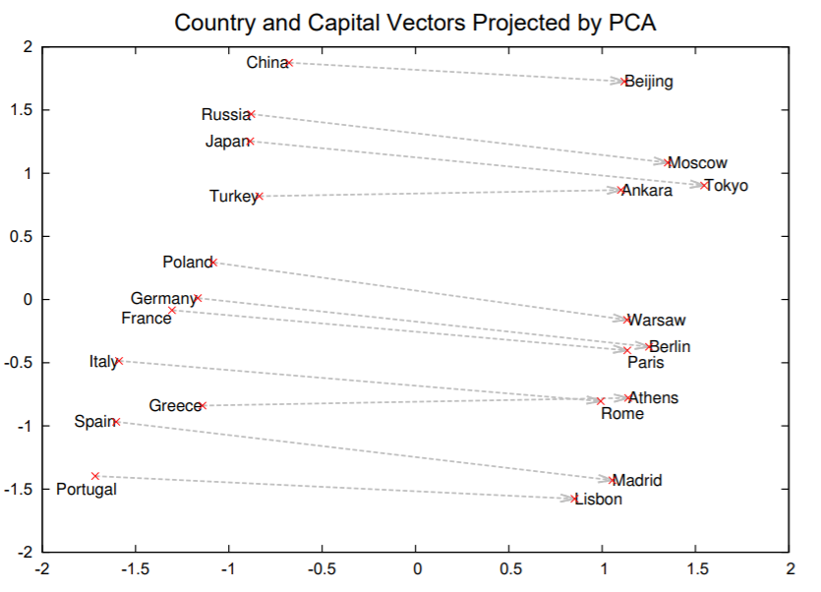
Mikolov, Tomas, et al. "Distributed representations of words and phrases and their compositionality." Advances in neural information processing systems. 2013.

Slide 5
Word Embeddings
If the words with similar context tend to be close with each other,
how can we model the words in a sentence based on this hypothesis?
i.e., “Please take your coat, it is cold outside.”
One way : estimate “coat” from (please, take, your, it, is, cold) => C-BOW model
Other way : estimate (please, take, your, it, is cold) from “coat” => Skip-gram model

Slide 6






Skip-gram model : brief description
i.e., “Please take your coat, it is cold outside.”
Estimate <context words> (please, take, your, it, is cold) from <target word>, “coat”.
Output
: target embedding
vector
Output
: context embedding
vector
Input
: one-hot
encoding of
“coat”
Input
: one-hot
encoding of
“take”

Slide 7

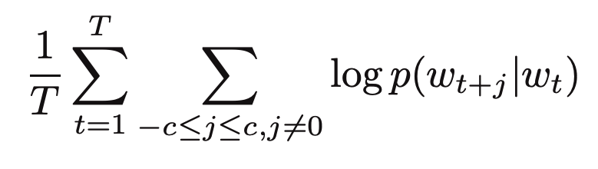
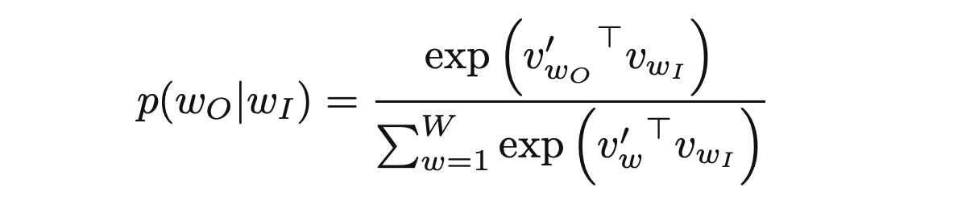


Skip-gram model : brief description
i.e., “Please take your coat, it is cold outside.”
Estimate <context words> (take, your, it, is cold) from <target word>, “coat”.
For a sequence of words, , the objective of skip-gram model would be maximizing..
The skip-gram model defines the conditional probability with softmax function
Can we get this?

Slide 8
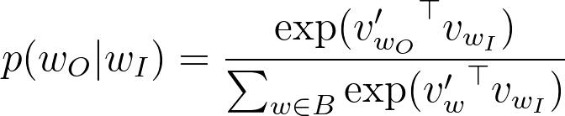
Skip-gram model : negative sampling
i.e., “Please take your coat, it is cold outside.”
“It is summer! Let’s go swimming.” ← Another (far-away) sentence
Positive samples (labels : 1)
(coat, Please), (coat, take), (coat, your), (coat, it), (coat, is), (coat, cold)
Negative samples (labels : 0)
(coat, summer), (coat, swimming), (coat, go),....
Construct a batch with pos/neg samples, and solve classification problem with it.

Slide 9
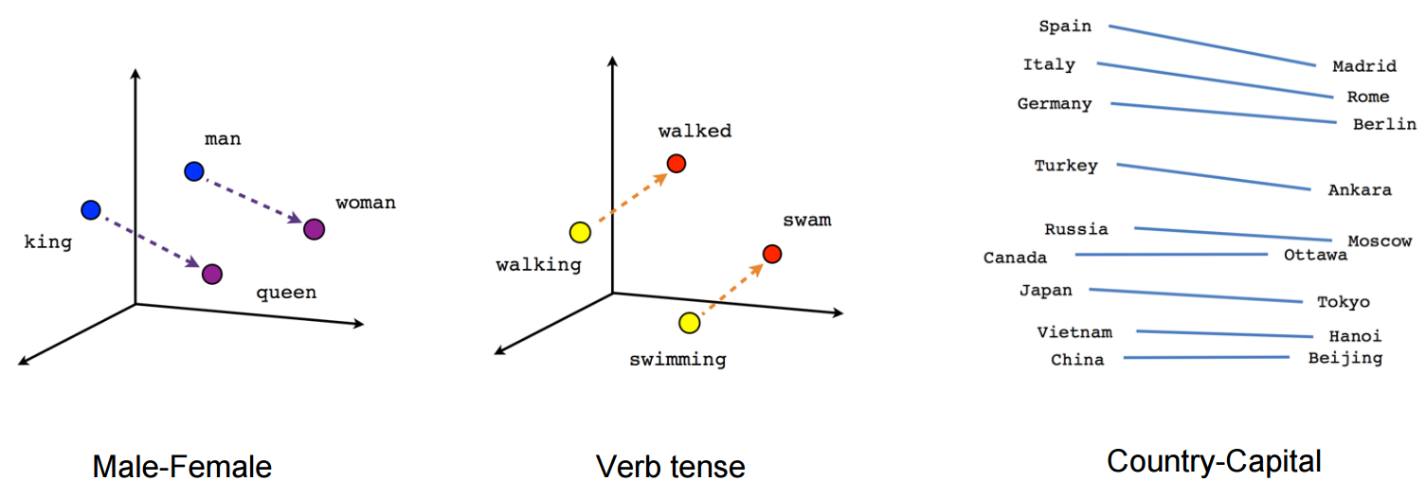
Result of Word2Vec

Slide 10
Recurrent Neural Networks
Human remembers and uses the pattern of sequence.
Try ‘a b c d e f g…’
But how about ‘z y x w v u t s…’ ?
The idea behind RNN is to make use of sequential information.
Let’s learn a pattern of a sequence, and utilize (estimate, generate, etc…) it!
But HOW?

Slide 11
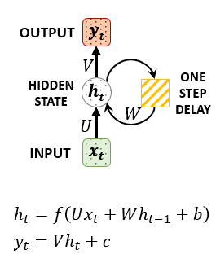
Recurrent Neural Networks
RNNs are called “RECURRENT” because they perform the same task for every element of a sequence, with the output being depended on the previous computations.
RNNs have a “memory” which captures information about what has been calculated so far.
The hidden state h_t captures some information about a sequence.
If we use f=tanh⁡ , Vanishing/Exploding gradient problem happens.
For overcome this, we use LSTM/GRU.

Slide 12
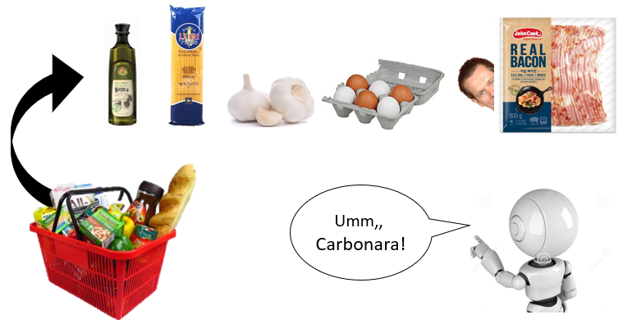
Recurrent Neural Networks : LSTM
Let’s think about the machine, which guesses the dinner menu from things in shopping bag.

Slide 13
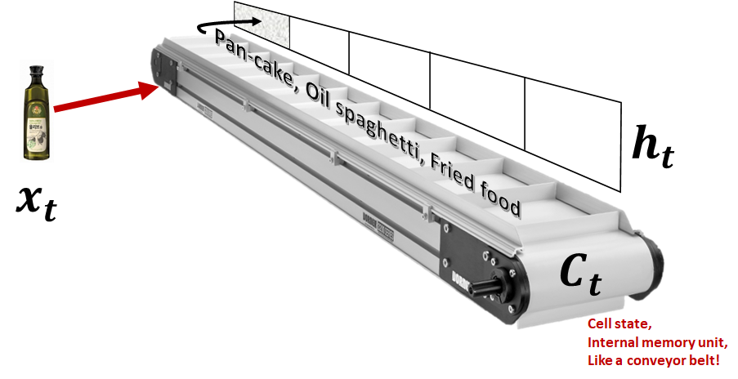
Recurrent Neural Networks : LSTM

Slide 14
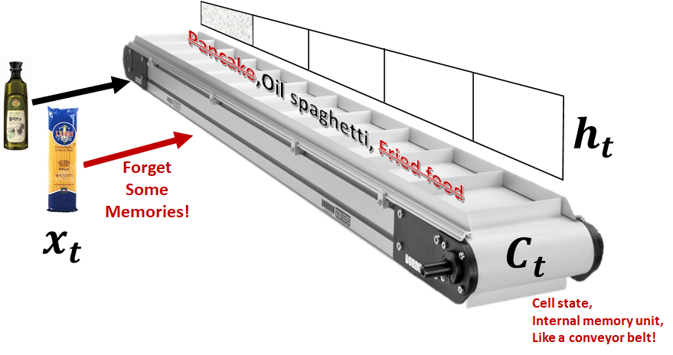
Recurrent Neural Networks : LSTM
LSTM learns (1) How to forget a memory when the h_(t-1) and new input x_t is given,
(2) Then how to add the new memory with given h_(t-1) and x_t.

Slide 15
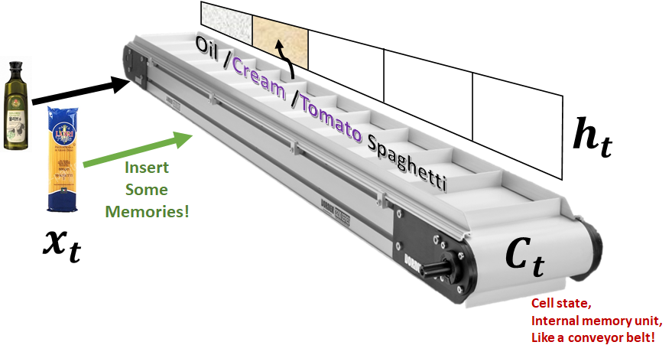
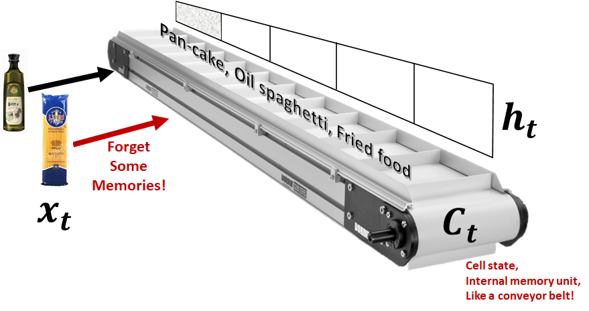
Recurrent Neural Networks : LSTM
LSTM learns (1) How to forget a memory when the h_(t-1) and new input x_t is given,
(2) Then how to add the new memory with given h_(t-1) and x_t.

Slide 16
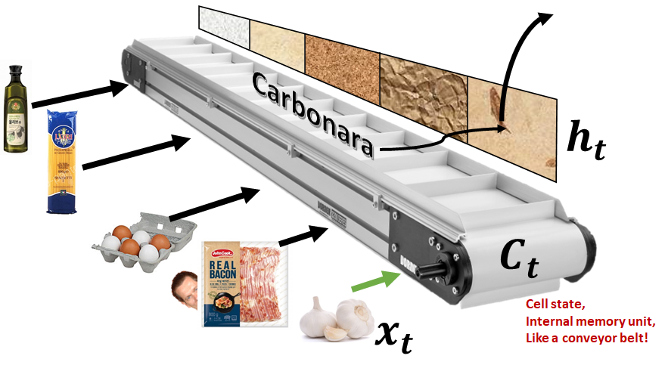
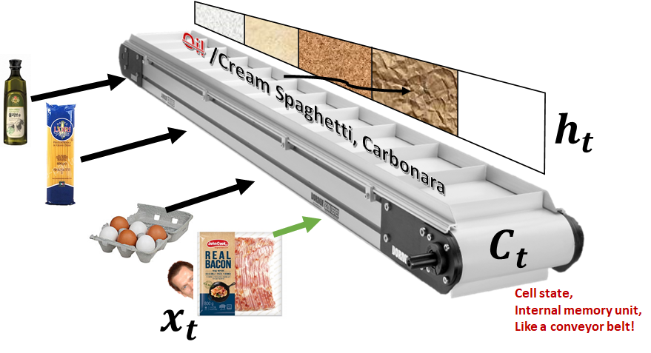
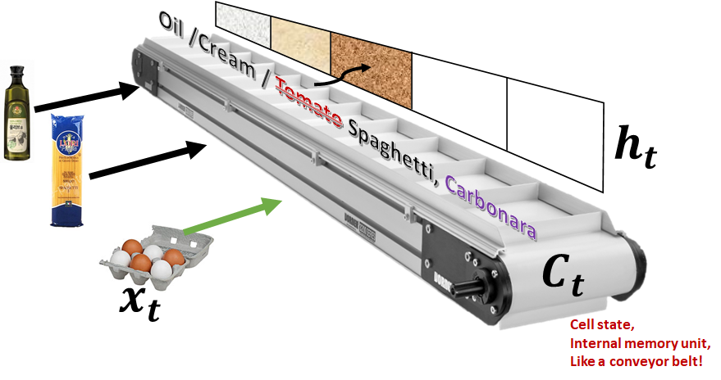
Recurrent Neural Networks : LSTM
LSTM learns (1) How to forget a memory when the h_(t-1) and new input x_t is given,
(2) Then how to add the new memory with given h_(t-1) and x_t.

Slide 17
Recurrent Neural Networks : LSTM
LSTM learns (1) How to forget a memory when the h_(t-1) and new input x_t is given,
(2) Then how to add the new memory with given h_(t-1) and x_t.

Slide 18
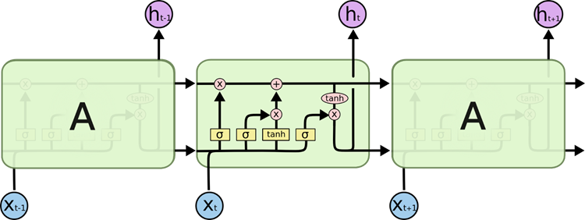
Recurrent Neural Networks : LSTM
LSTM learns (1) How to forget a memory when the h_(t-1) and new input x_t is given,
(2) Then how to add the new memory with given h_(t-1) and x_t.
https://colah.github.io/posts/2015-08-Understanding-LSTMs/

Slide 19
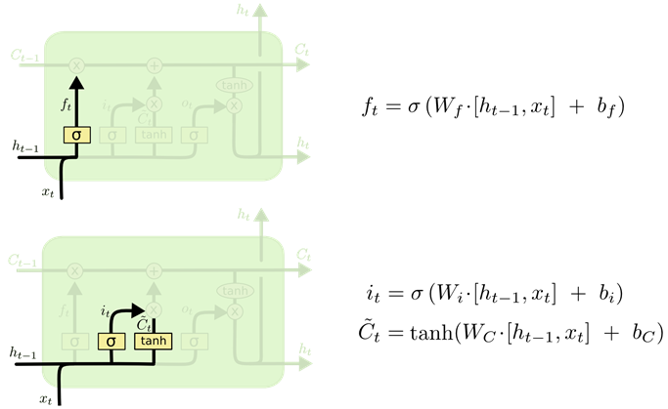
Recurrent Neural Networks : LSTM
LSTM learns (1) How to forget a memory when the h_(t-1) and new input x_t is given,
(2) Then how to add the new memory with given h_(t-1) and x_t.

Slide 20
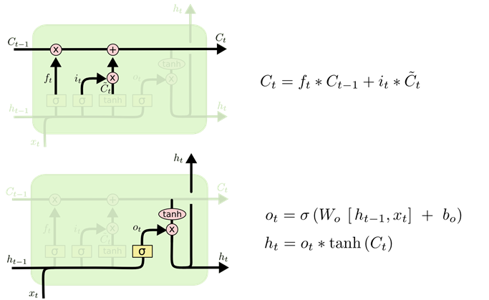
Recurrent Neural Networks : LSTM
LSTM learns (1) How to forget a memory when the h_(t-1) and new input x_t is given,
(2) Then how to add the new memory with given h_(t-1) and x_t.

Slide 21
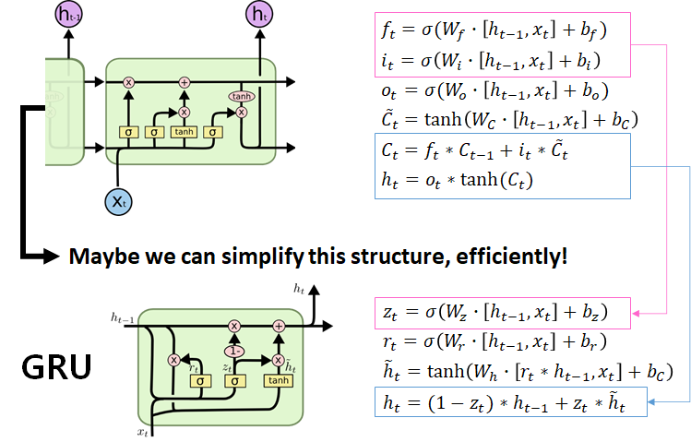
Recurrent Neural Networks : LSTM - and GRU

Slide 22
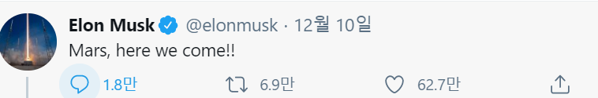
Word2Vec + RNN : What can we do?
i.e., Twitter Generator
here we come <EOS>
What would happen,
if this model is trained
to solve a classification problem,
with this “shifted sentences” as a GT label?
Recurrent Neural Networks
Word2Vec Embeddings
Mars here we come

Slide 23
Any Questions?

